Slide 1
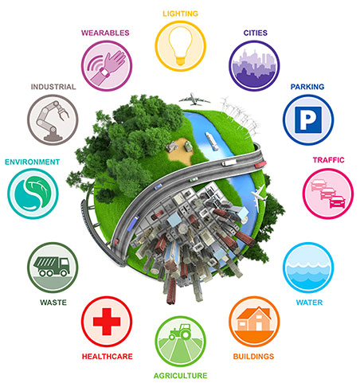
Green Technology & IoT

Slide 2
Why Green Tech & IoT
Global warming and climate change
Population increase and resource depletion
Adverse effects of increasing urbanization

Slide 3
Topics We’ll Talk About
Agriculture
Smart Cities
Smart Homes

Slide 4
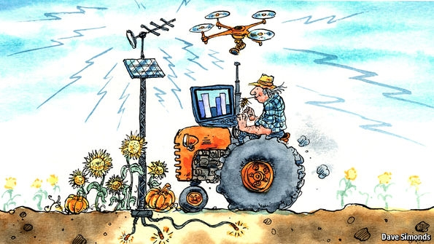
Green
Agriculture
IoT

Slide 5
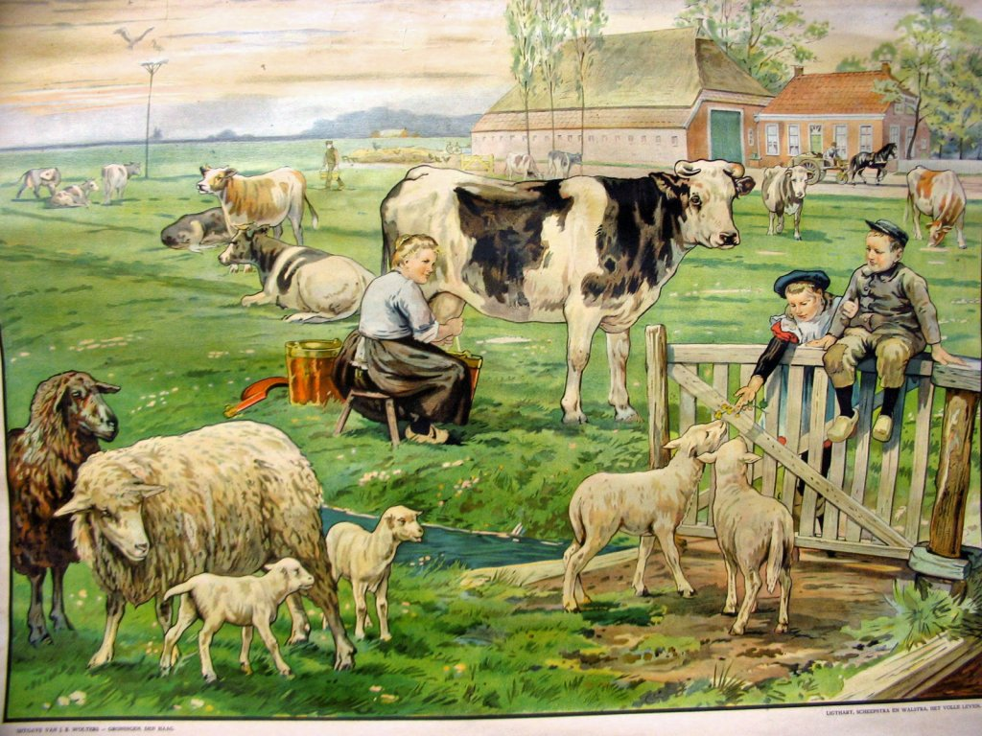
Classic Farming

Slide 6
Challenges
The agriculture industry is faced with challenges:
The limited availability of arable land
Global climate change
The growing scarcity of water
The price and availability of energy, particularly from fossil fuels
The impact of urbanization on rural labor supply.

Slide 7
Challenges - Technology
Too much information
Energy
Connectivity

Slide 8
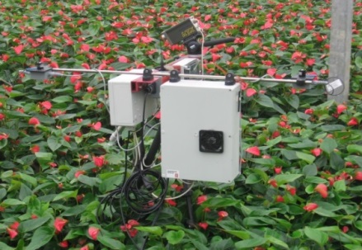
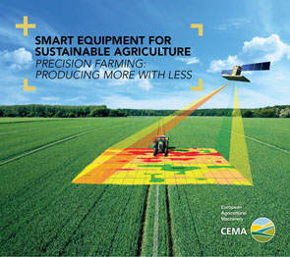
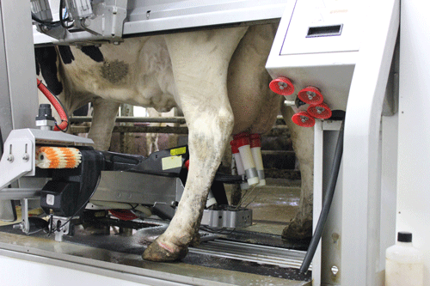

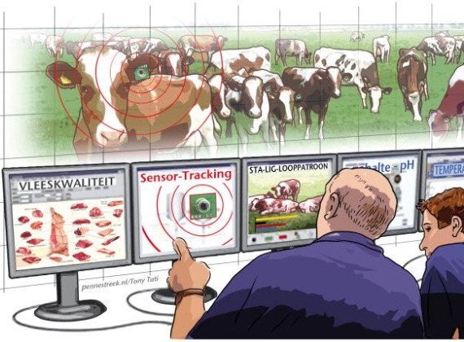
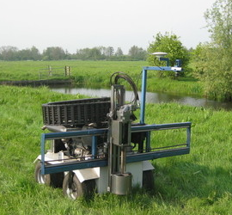
Future Farming
smart sensing & monitoring
BIG DATA
smart control
smart analysis & planning

Slide 9
IOT & Farming
Precision agriculture - 'smart farming’
Precision agriculture is based on sensor technologies

Slide 10
IOT & Farming
Past farmers - Walking around their farms.
A remote 'eye in the field'.
M2M-derived - decision support system.
The approach of science to the field is a new trend.

Slide 11


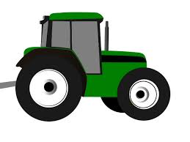
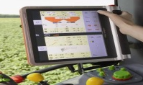
Redefining Industry Boundaries (according to Porter and Heppelmann, Harvard Business Review, 2014)
3. Smart, connected product
2. Smart Product
1. Product
+
+
+

Slide 12

Redefining Industry Boundaries (according to Porter and Heppelmann, Harvard Business Review, 2014)
5. System of systems
weather
maps
weather forecasts
4. Product system
weather data
application
rain, humidity,
temperature sensors
weather data system
farm
management
system
farm
performance
database
planters
farm equipment system
farm equipment system
seed optimizing system
combine
harvesters
seed
database
tillers
irrigation system
seed
optimization
application
field
sensors
irrigation
application
irrigation
nodes
Notes:
Current Farm management systems are not capable to do what is suggested in the picture. Therefore we have developed FIspace!

Slide 13
Connectivity
Wireless communications - from 2G to 4G
Rural environments - Signal Problem
Satellite
long-battery life -> low-data rate even 2G connectivity can be expensive when available
The new range of LPWAN (Low Power Wide Area Network) is seen as a potential substitution of cellular connectivity in long battery life, long range connectivity scenarios and affordable rates (between 2 and 14 Euros per year).

Slide 14
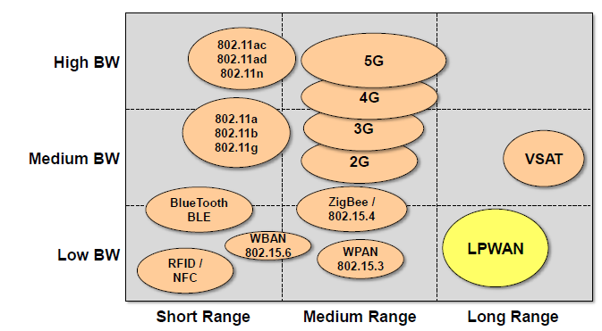
LPWAN

Slide 15
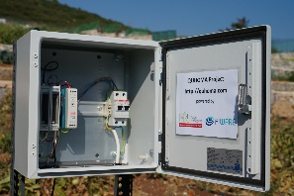
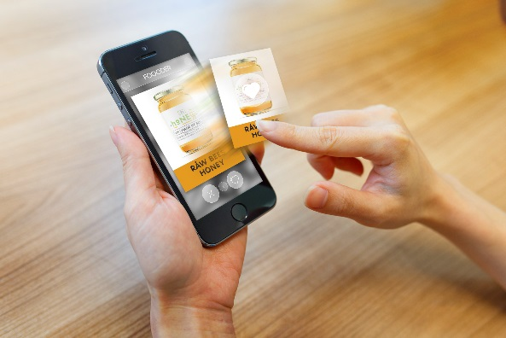


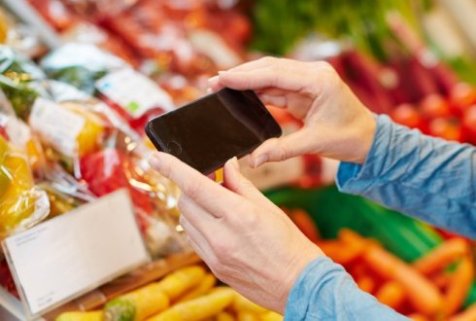
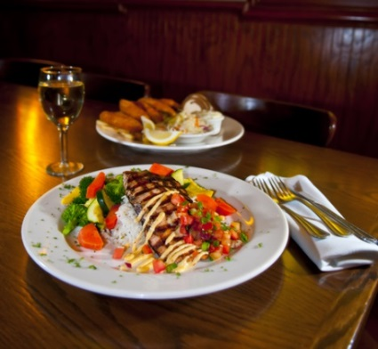
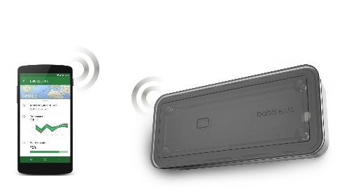
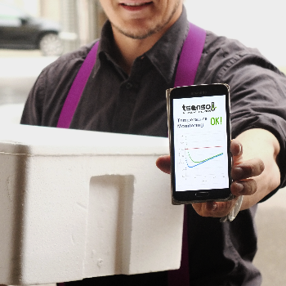
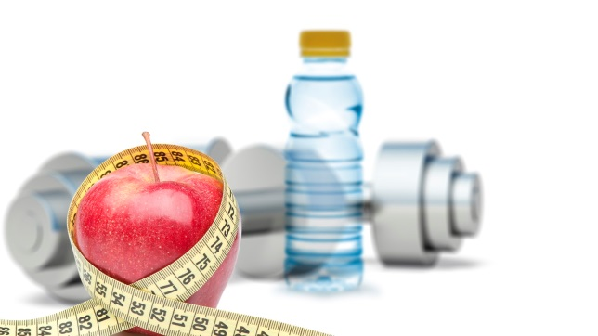
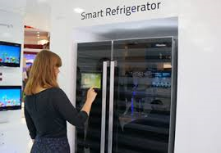

Involving the entire supply chain network and beyond
Smart Farming
tracking/& tracing
Smart Logistics
Fitness/Well-being
Domotics
Health
Source: Hisense.com
Notes:
SW: through smart production (farming) and logistics food ends at the consumers plate
Smart tracking and tracing is necessary to provide the right information about the product (contents, freshness, etc.)
This information can be related to other (IoT) domains such as:
Domotics (recipes, shopping, etc.)
Health (allergies, obesitas, etc.)
Fitness/Well-being (calorie-metering, healthy ingredients, etc.)
HS: There are already several examples from FIWARE phase 3, like tsenso, Babbler, Quhoma, Foooder

Slide 16
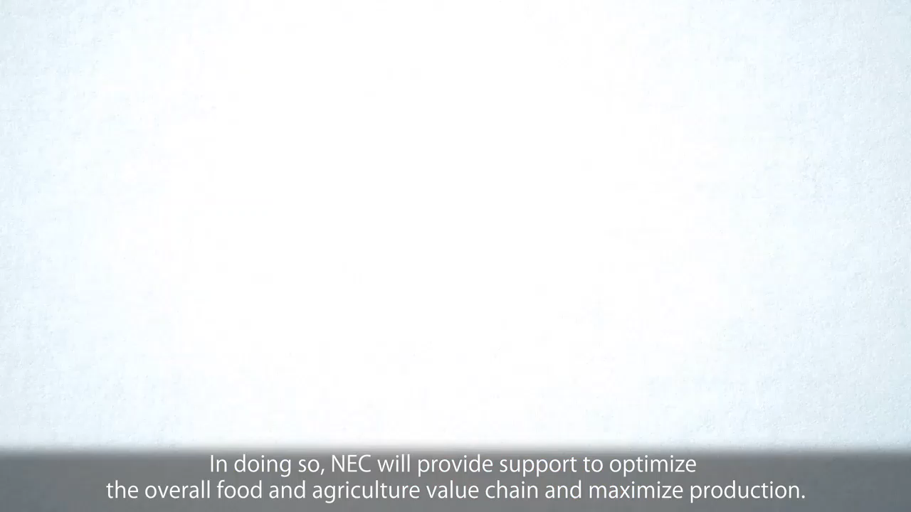

Slide 17

Smart Cities

Slide 18
Smart City
Monitor city-wide resources and consumption
Efficiently allocate resources
Allows city officials to interact directly with the community and fix problems as they arise
Notes:
ICT allows city officials to interact directly with the community and the city infrastructure and to monitor what is happening in the city, how the city is evolving, and how to enable a better quality of life.

Slide 19
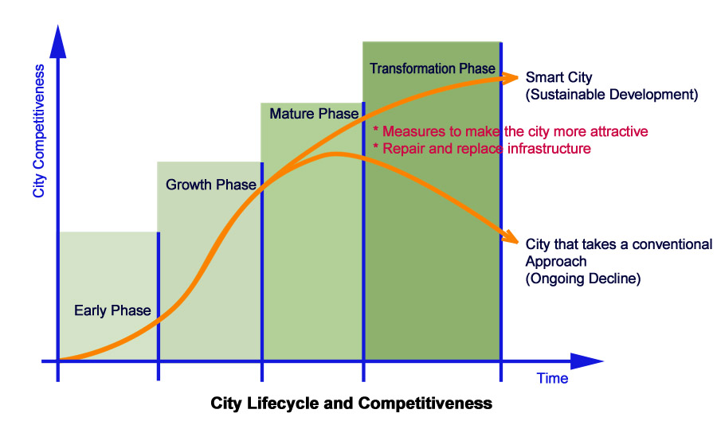
Why Smart Cities are needed now?
¹Enhancing city competitiveness - In terms of services (education ,healthcare), waste management, water management, transportation, safety etc.
Notes:
Managing the lifecycles of cities
Early phase: Provide the infrastructure needed for the operation of the city.
Growth Phase: Expand and intensify the infrastructure to ensure that supply can keep the pace with increasing demands of the growing demand.
Mature phase: Enhance infrastructure to ensure the delivery of high-quality services based on criteria such as ease-of-use and comfort.
Transformation phase: Integrate infrastructure systems to satisfy social values such as aiding, or at least avoiding damage to the natural environment.

Slide 20
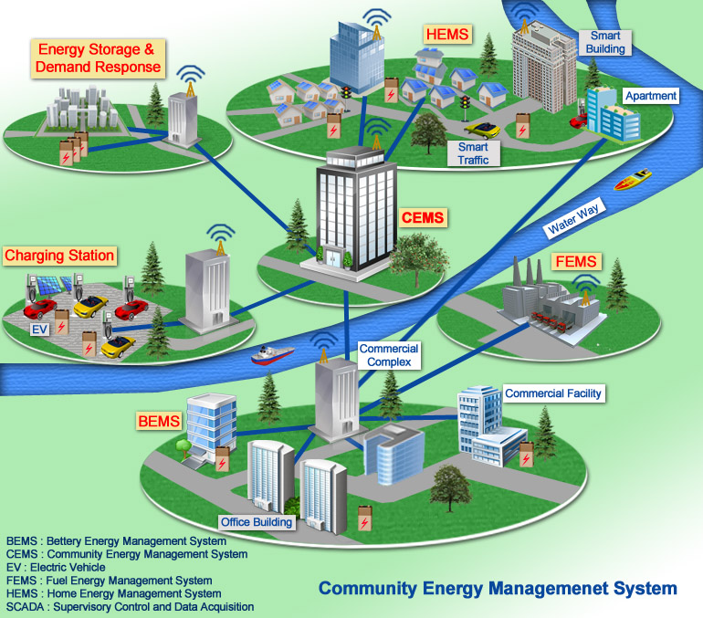
Smart City Example
Notes:
Smart Building & Home
Smart Transportation
Smart Energy (renewable generation & storage)
Smart Water Management
Smart Waste Management (recycling of waste, residual management, Recovery of waste organics & Energy)
Smart Education (e-Education)
Smart Medical Facility (e-Medical)
Smart Communications
Smart Networks

Slide 21
Green at Home
Saving Energy, Water and Money on a daily basis

Slide 22
IoT can help make the world a greener place
Smart appliances allow you to use only the exact amount of water and energy needed.
Promotes awareness of resource consumption and encourages you to be more water and energy efficient.
Connect to your city’s Smart Grid and cause less strain on its resources during peak hours.

Slide 23
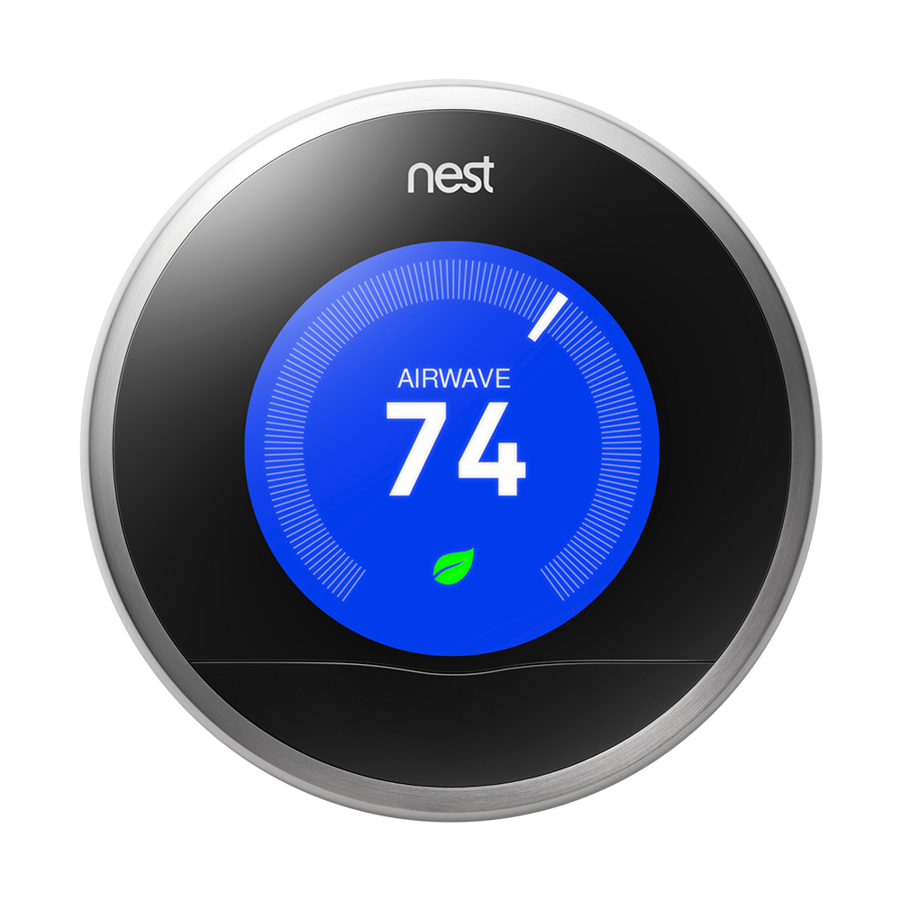
Smart A/C Systems
Only heat/cool the rooms or areas that you actually spend time in.
Control thermostat from your laptop or phone, or let it learn your schedule automatically.
Saves 10-12% in heating, 15% in cooling.
Saves $130-$145 per year in heat and cooling costs. It pays for itself after just 2 years.

Slide 24
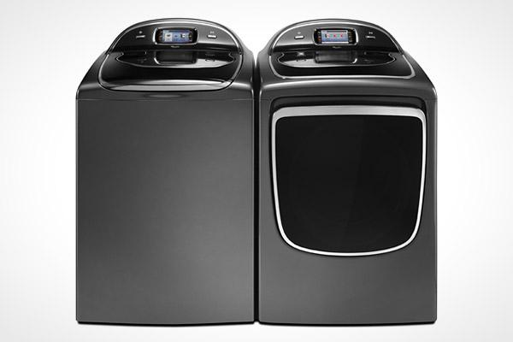
Smart Washer and Dryer
Detects the amount of clothes loaded and can adjust the water and energy used.
Includes app to track savings over time. Typically uses 75% less water and power.

Slide 25
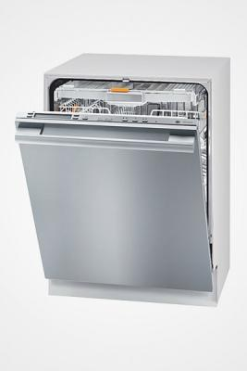
Smart Dishwasher
Detects how many dishes are inside and uses the needed amount of water and detergent.
Soil Sensor determines how dirty dishes are and adjusts accordingly.
Connects to the Smart Grid and can run only during off-peak hours.

Slide 26
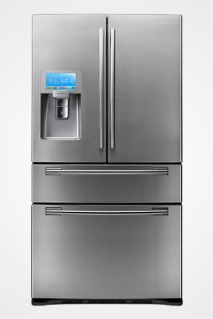
Smart Refrigerator
Different temperature and humidity zones for different types of food.
Power-saving mode to conserve energy when nobody is home through the app.

Slide 27


Smart Grid
In some countries like the US, utility companies charge less for electricity used in the middle of the night, when there is less strain on the system.
Appliances like a refrigerator could delay its energy-intensive tasks (like its defrost cycle) until those times.

Slide 28
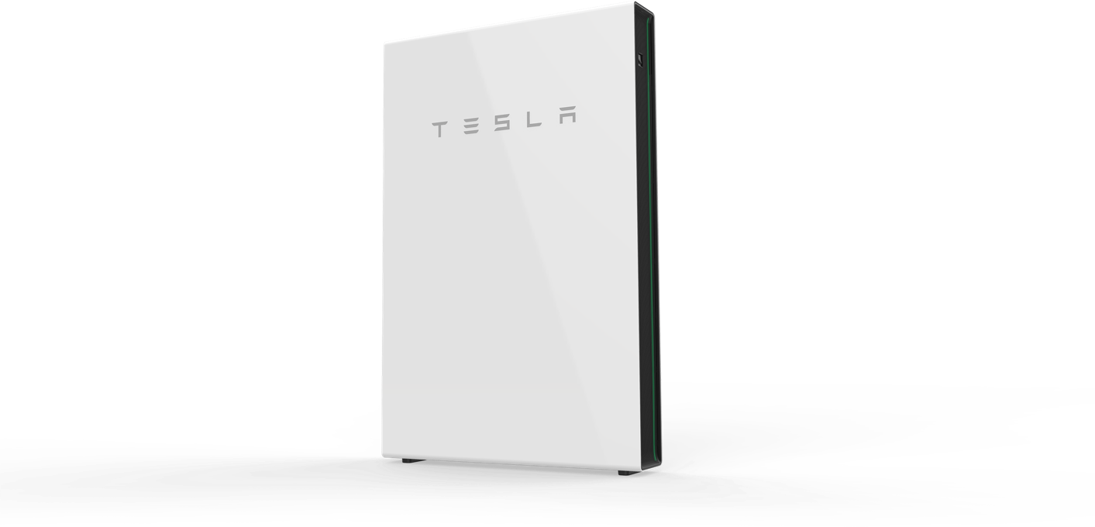
Generating Power
Solar panels and Tesla’s Powerwall allow for generating and storing energy for your home.
As this technology improves, homes can become 100% energy independent.

Slide 29
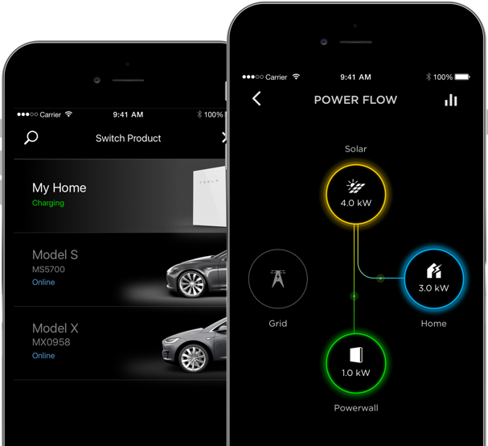
Generating Power (Cont.)
Track how much energy has been generated, used and is currently stored.
Pays for itself in 6 years.
Can even sell energy back to utilities.

Slide 30
Questions?

